Slide 1
Junior Year
PSAT Interpretation
Spring Semester
Today you will learn about:
What do my PSAT Scores Mean
Preparing for the SAT
Next Steps
SAT VS. ACT
Next steps
Extra curricular activities
Post secondary options

Slide 2
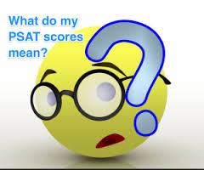

Slide 3
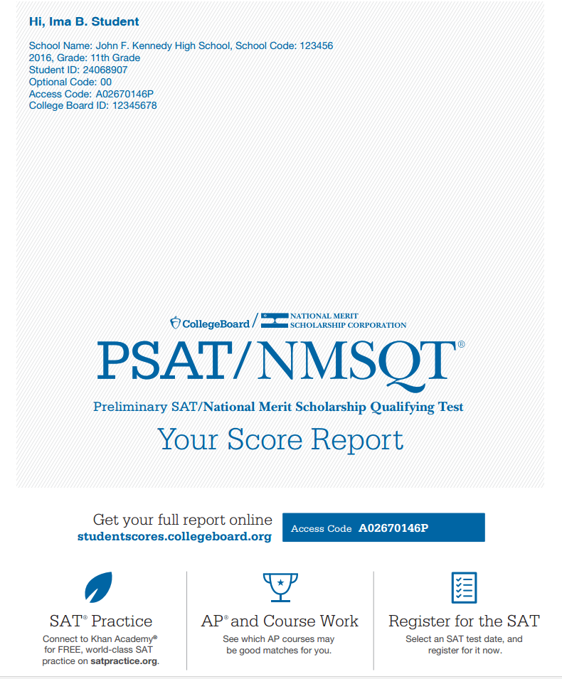
PSAT - Student Score Report AccessInstructions

Slide 4
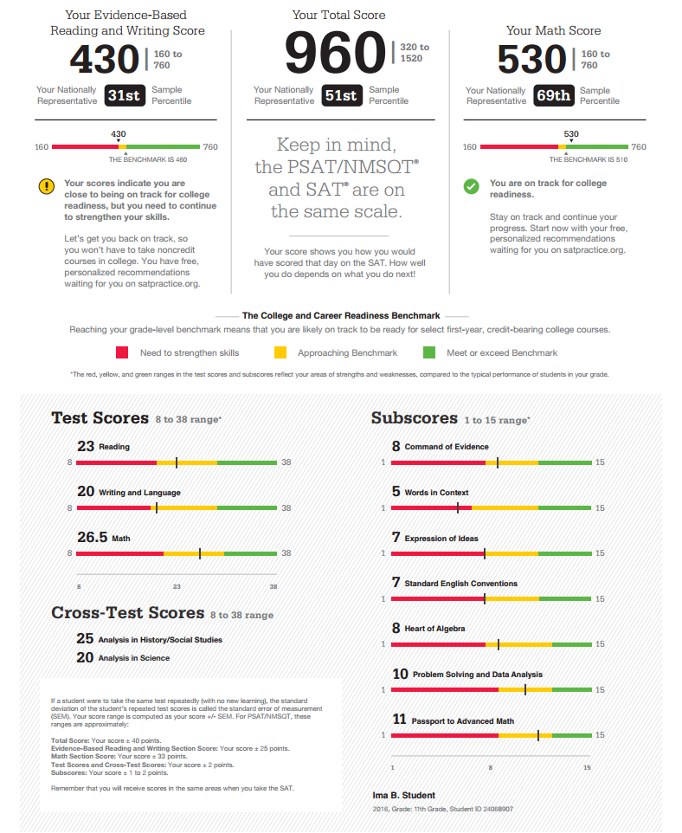

Slide 5
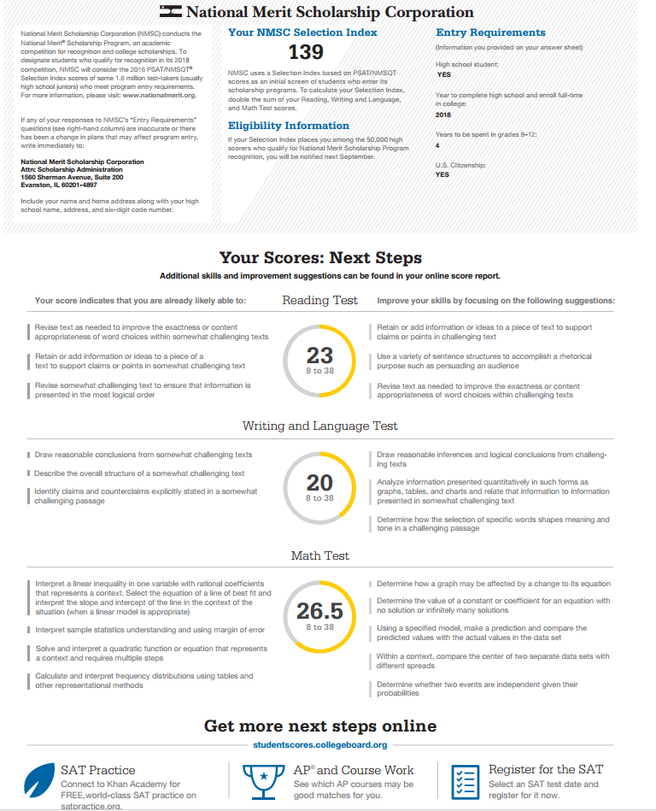

Slide 6
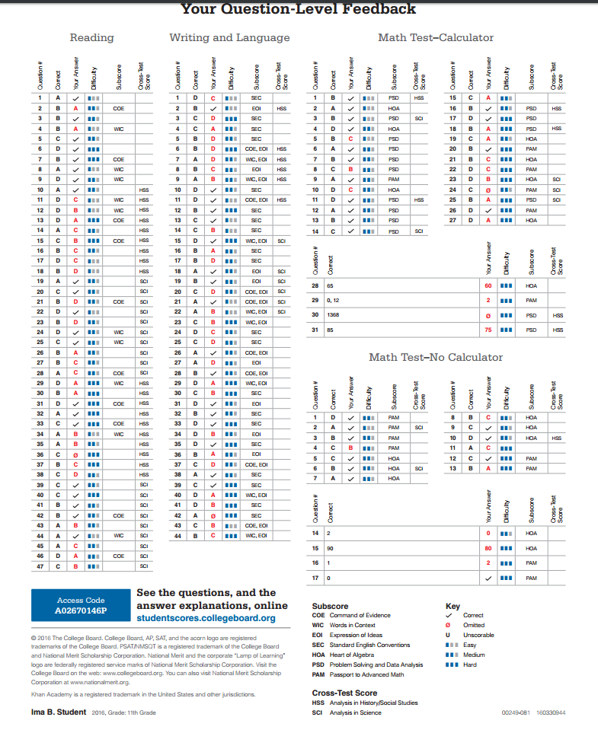

Slide 7
Logging into the Student Portal
Go to studentscores.collegeboard.org.
If you already have a College Board account, you should sign in with your username and password and click “Sign In” to be taken to your scores.
If you don’t have an account, you can create one by clicking “Sign Up” and entering the required information.
Only the information marked with an asterisk (*) is required.
Your should now be able to view your scores on all the College Board assessments you’ve taken.

Slide 8
Free Practice at Khan Academy
Steps for Linking Student Accounts
Step 1: Visit satpractice.org.
This is where you can log in or create a Khan Academy account.
Step 2: Link accounts.
When prompted, you must agree to link your Khan Academy and College Board accounts.
Step 3: Send test results.
Students must sign in or create an account at collegeboard.org and click “Send” to send your scores to Khan Academy for a personalized practice plan.

Slide 9


Slide 10

Register for SAT Tier One Prep Course with Ms. Guyer $99 By Friday 1/20/17 – Class starts Wed 2/8/17 & ends 3/8/17
Register for the SAT Reasoning + Writing and Subject Tests (optional) @ www.collegeboard.com – Next test 3/11/17 Deadline to register Feb. 10, 2017.
Register for ACT + Writing @ www.act.org – Next test 4/8/17 Deadline to register March 3, 2017.
Tests are Saturdays off campus and you choose testing location from list provided during registration

Slide 11

You can find registration deadlines and test dates on the Katella website
See Ms. Diaz in the College and Career Center for a fee waiver or if you need help with registration for any of these tests

Slide 12
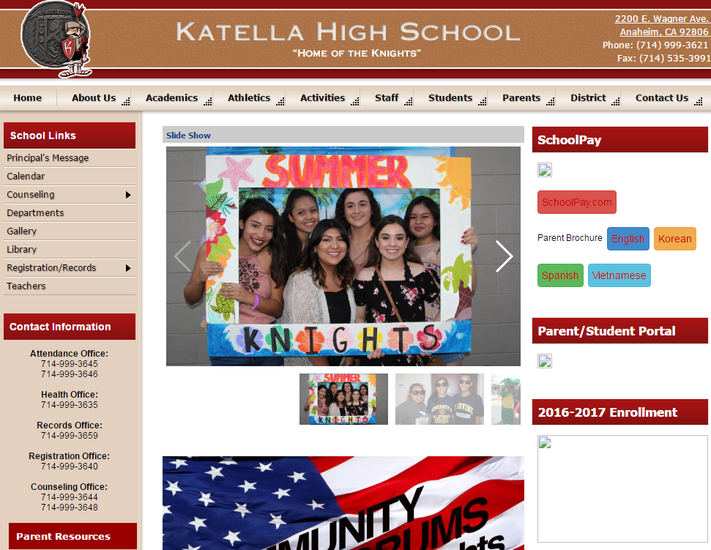
HOW TO SIGN UP
Log on to: http://katella.auhsd.us/
Click:
Counseling
Testing

Slide 13
Why take the SAT or ACT?
How Important Are Standardized Tests to admission representatives?
*Required by Cal-State, UC & Private Universities
*Tie Breaker
*Will this student’s score help our college admissions statistics
Notes:
Two students with similar academic profile -- tie breaker
How will they hold up on the national ranking list thereby improving the academic recruiting power

Slide 14
Standardized Test Timelines
 | Fall | Spring
Junior Year | PSAT | SAT &/or ACT SAT Subjects*
Senior Year | Retake** SAT &/or ACT
*Some privates - Some UC majors
**Retake only if necessary
Notes:
Stand

Slide 15
When Should I Take these TESTS?
You should have your tests taken by
SAT June 3, 2017
ACT June 10, 2017
Senior testing is only to IMPROVE your score and must be taken no later than December, 2017

Slide 16
SAT
Scholastic Achievement Test
3h 50m reasoning exam + essay
Measures: Total Time
    Reading 65 minutes
    Writing & Language 35 minutes
    Essay (optional) 50 minutes
    Math 80 minutes

Slide 17
SAT
Scholastic Achievement Test Cont.
  Mathematical Aptitude
    Total Time: 80 Minutes
      Heart of Algebra - Linear Equations & Systems
      Problem Solving & Data analysis
      Passport to Advanced Math
      Geometry and Trigonometry most relevant to college and career readiness
      Calculators allowed

Slide 18
SAT
Scholastic Achievement Test Cont.
  Scoring
  200 - 800 - Reading & Writing
  200 - 800 - Math
  Total:
  200 - 1600

Slide 19
SAT II Subject exams
  Subject Specific
  800 Points Each
  Helps determine strength in subject matter
  Take after taking the highest level of the corresponding course
  Private Schools
  Major Considerations (UC Schools)
  NOT Cal STATE

Slide 20
ACT
American college test
  3h and 35m
  Measures:
    English
      Usage, mechanics, rhetorical skills
    Reading
      Comprehend and answer questions about paragraphs
    Mathematics
      Algebra and Trigonometry
    Science
      Graphs, experiment summaries, research viewpoints
    Writing Section (Optional)
      CSU schools do not
      Recommended if other schools are on the potential list
      30 minutes
      Cost more

Slide 21
ACT
American college test
  Scoring
  Composite Score
  1 – 36
  Subscores:
  Used more for the student

Slide 22
Comparison
Test Structure and Format | ACT | New SAT
Length | 3 hours, 35 min (with optional Writing Test) | 3 hours, 50 minutes (with optional Essay)
Structure | 4 sections (English, Math, Reading, Science) plus an Optional Essay (or Writing Test) | 4 sections (Evidence-Based Reading, Writing, Math without a calculator, Math with a calculator) plus an Optional Essay

Slide 23
Comparison Cont.
Scoring | ACT | New SAT
Score | Composite of 1-36 based on average scores from the 4 test sections 4 scores of 1-36 for each test Optional Writing Test score of 1-36 (not included in the overall) | Score is out of 1600: 800 for Math, 800 for Evidence-Based Reading and Writing Optional Essay receives a separate score Subscores and insight scores available
Wrong Answer Penalty | No penalty for wrong answers | No penalty for wrong answers
Sending Score History | You decide which score is sent | Not yet known

Slide 24
Comparison Cont.
Content | ACT | New SAT
Reading | Reading Comprehension | Reading Comprehension Words in Context Evidence Based
Math | Arithmetic Algebra Geometry Algebra II Trigonometry | Algebra Data Analysis Geometry Trigonometry Algebra II
Science | Analysis Interpretation Evaluation Basic Content Problem Solving | Science Insight Score Provided
Writing and Language | The Essay: Writing Test English Test: Writing & Language multiple-choice questions | Tests grammatical and rhetorical skills
Essay | Optional final section 40 minutes Not included in composite score Topic presents conversations around contemporary issues | Optional final section 50 minutes Separate score Tests Reading, Analysis, and Writing Skills Topic comes from a 750-word passage to be read on Test Day

Slide 25
What else do colleges want?
Strong GPA – focus on maintaining or raising your GPA, meet with counselor to make up Ds or Fs
Challenging course work – Honors and AP classes
Extra Curricular Activities – sports, work, community service, etc.

Slide 26
Extracurricular
Helps the colleges know the WHOLE person
You learn non-academic skills
Develop a sense of accomplishment
Meet peers/mentors outside of class
Current Juniors:
  Build Leadership opportunities
    Clubs, sport teams, etc.
  Seek out of school opportunities
Senior Year:
  Continue developing those contacts
  Take on a new level of challenge/leadership
  Make it relevant

Slide 27
Extracurricular
Quality
Over
Quantity

Slide 28
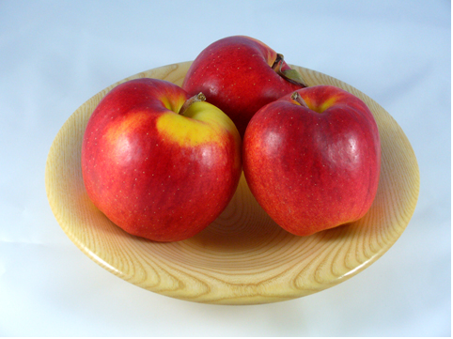
Extracurricular
The Well Rounded Student

Slide 29

INSTEAD…..

Slide 30
Extracurricular--Suggestions
Activities In School
Activities Outside of School
Pursue activities that interest you(not the college).
List everyone you know and what they are related too (construction, law, etc.). Pursue experience with them.
Study the colleges locally and what specific research projects they are involved in…contact them.

Slide 31
Extracurricular
Strong Extracurricular Profile
Sustained Commitment
Increased responsibility over time
Creativity
Demonstration of student’s strengths
Genuine enthusiasm in activities

Slide 32
Extracurricular
What should you take away from the activities:
What have you learned from the activities
What has it taught you about yourself today and how it relates to your future goals
Whether you enjoy the experience--and why?

Slide 33

So, what college do you want to attend?

Slide 34
College list building goal
Schools Determined:
August 2017
Why?

Slide 35
California State Universities
CSU’s
Public university
Simi-Selective college

Slide 36
CSU Schools
Affordability
  Cost of Tuition: $5,472
  Cost of Tuition / Room and Board: $17,350 (approximate)
Accessible
  Many financial packages help subsidize the cost
  Cal Grant, State University Grant (SUG), EOP
  Each Campus has a variety of scholarships
Class Size
  General Ed courses are higher
  Major Courses 25-40– depends on the school
Diverse
  Many ethnic and/or racial backgrounds
Successful
  Many students experience a 5-year pattern

Slide 37
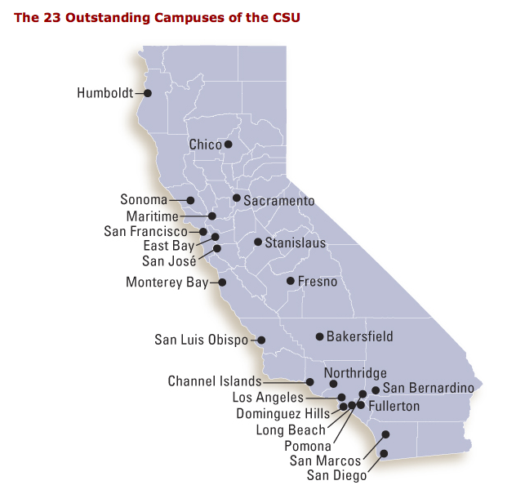
CSU Schools

Slide 38
University of California
The UC’s
Public university
Selective college

Slide 39
UC Schools
Affordability
  Cost of Tuition: $13,500
  Cost of Tuition / Room and Board: $34,200
Accessible
  Many financial packages help subsidize the cost
  Blue and Gold Opportunity Plan— Tuition Paid
    Parents making less than $80,00--qualify for financial aid--
Class Size
  20:1 ratio – depends on the school
Diverse
  Many ethnic and/or racial backgrounds
Successful
  Sustained Effort = 4 Years

Slide 40

UC Schools

Slide 41
UC Schools
General Information
10 UC schools in California – UCI-UCLA-Berkeley—San Diego
More theoretical, philosophical, and research based learning
Each school offers educational instruction up through the doctoral and professional degree level
More UC academic programs are consistently rated among the top 10 nationally than any other public or private university.
Who Should Apply?
Students who are eventually pursing doctoral level studies or planning to go into research and discovery based careers
Students who have found a program that matches their individual career needs

Slide 42

Private Schools/ Independent Colleges
Cost
Does it cost more?

Slide 43
Private Schools/ Independent Colleges
Not Always

Slide 44
Private Schools/Independent Colleges
Affordability
  Cost structure can be as low as a UC school
  86% of students receive student aid
Accessible
  Students overall receive 1.4 billion in student financial aid
Class Size
  12:1 ratio – typical
Diverse
  Many ethnic and/or racial backgrounds
Successful
  The majority of the students graduate in four years
  This saves money

Slide 45


